Slide 1


AI-Powered QA Automation: Amazon Q & Custom Framework
Revolutionizing QA with AI-driven automation, custom agents, and seamless framework integration. Driving efficiency, accuracy, and collaboration in the testing lifecycle.
by Hùng Trần

Slide 2

The QA Automation Vision
Automation Tester
Enhanced Efficiency
Spearheading QA innovation
Streamlining test processes
Amazon Q Integration
Custom agent solution

Slide 3





Agent: Core Capabilities
Test Checklists
qTest Cases
Knowledge Base
Doc Links
Agent supports checklist creation, automates manual test case generation, answers questions, and suggests useful document links.

Slide 4
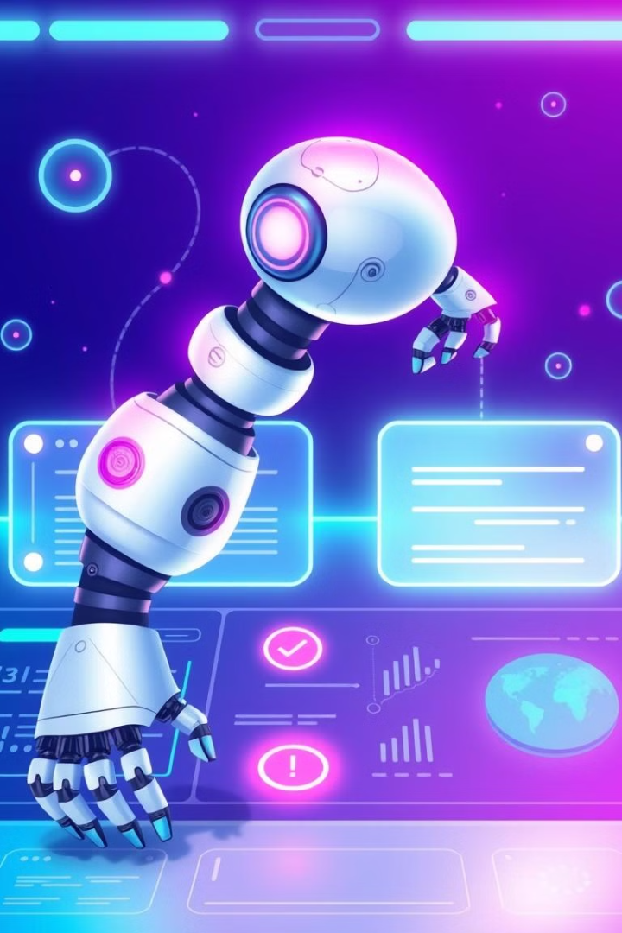
Agent: Advanced Automation
Test Case IDs
Module IDs
Drive test automation
Context aware generation
Reduced Effort
Seamless integration
Agent auto-generates automation test cases using Test Case and Module IDs from qTest. Effort is reduced with context-aware automation.

Slide 5
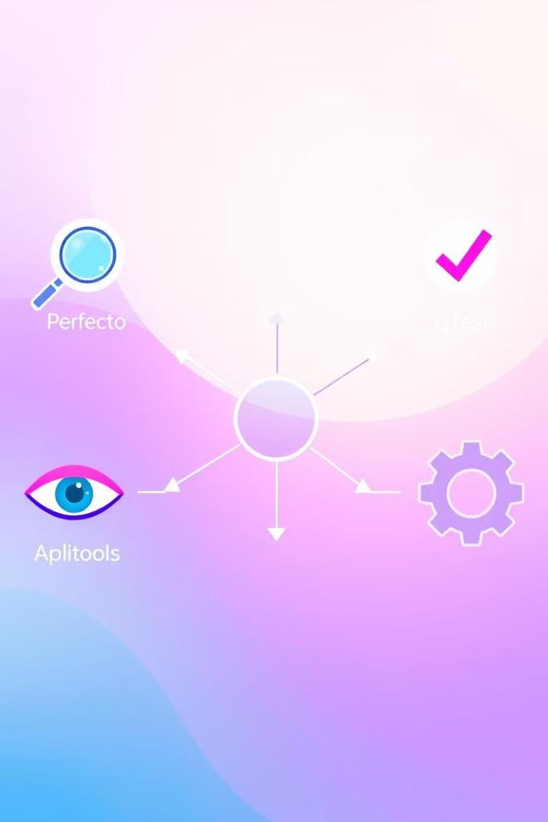



Framework Integration
Perfecto
qTest
Applitools
Custom framework integrates Perfecto, qTest, and Applitools with real-time test execution and result updates.

Slide 6





Workflow: Agent in Action
Generate checklist with team
Auto-create manual cases
Suggest resources
Generate automated test
Run tests; update results

Slide 7

Delivering Measurable Value
30%
15%
2x
Time Savings
Higher Accuracy
Improved Collab
Test case creation
AI generated tests
Shared checklists
Significant time saved, higher accuracy with AI, improved collaboration, and full integration with tools.

Slide 8

Future Roadmap
Platform Support
Extend agent integrations
Knowledge
Enrich domain-specific data
Automation Logic
Complex test scenarios
Future goals: Platform expansion, Knowledge enrichment, and advanced test scenarios.

Slide 9

Questions & Answers
Thank you! Let's discuss how we can evolve this solution together.

